Slide 1
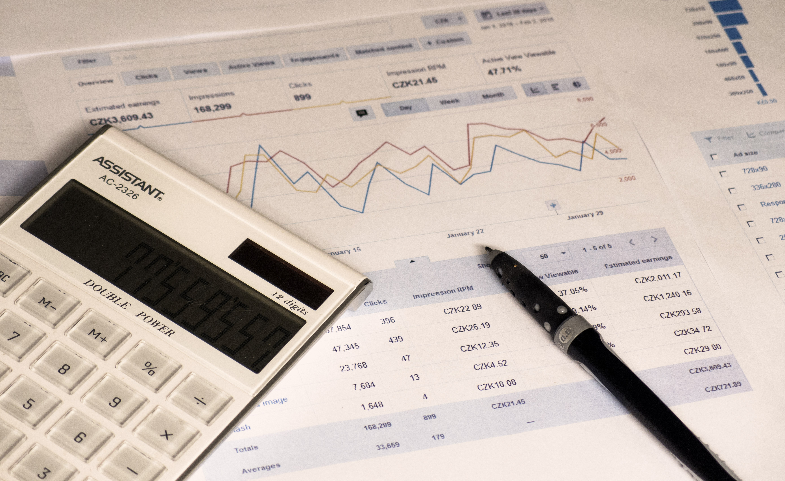

BANK ACCOUNT FINANCIAL INSIGHT
View in Power BI
PACIFIQUE NTETA
This Photo by Unknown Author is licensed under CC BY

Slide 2
1. PROJECT OVERVIEW
This is a financial analysis project. The objective of the project is to gain valuable insights from a personal 6 months bank statement, starting from June the 15th, 2023 to January the 15th, 2024. The project involves transaction categorization, expense tracking, and visualization of financial trends.
Tools :
- Microsoft Excel : Microsoft Excel was used to import the raw bank statement data(pdf), perform preliminary data cleaning and preparation using Power Query in the process.
- SQL Server : SQL Server is used for data exploration, further data preparation, transaction categorization and expense tracking.
- PowerBI : PowerBi will be used to visualize financial trends.

Slide 3
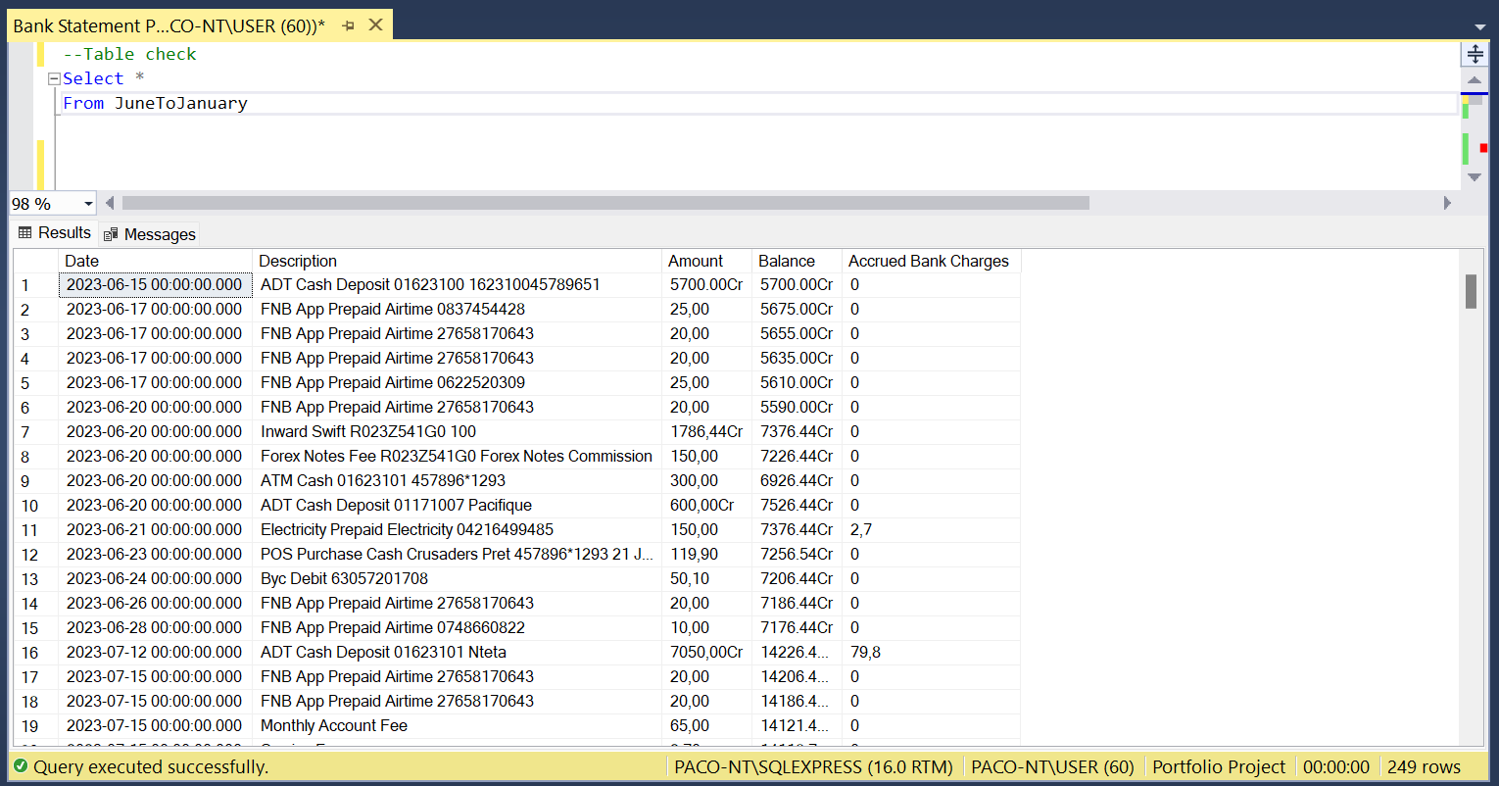
2. DATA PREPARATION
1. Table check

Slide 4
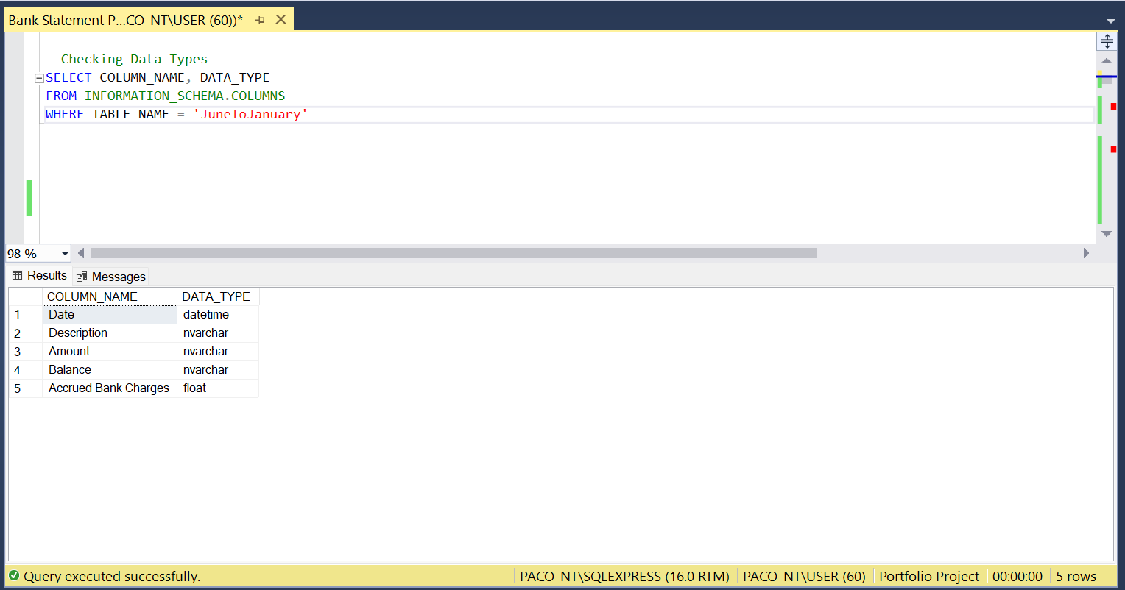
2. DATA PREPARATION
2. Data Type Check

Slide 5
2. DATA PREPARATION
OBSERVATIONS
The table shows that there is the presence of letters('Cr') in the columns 'Amount' and 'Balance'. These two columns are supposed to contain numbers only, the presence of 'Cr' will not make calculations on these columns possible.
We can also notice the presence of commas(',') in instead of points('.') to delimit decimals in the 'Amount' column. This will also make calculations in this column. These two issues will be addressed later.
Columns 'Amount' and 'Balance' are NVARCHAR which is a string data type, but it should be a number data type. And the 'Date' column appears as 'datetime' but since the time part doesn't reflect any info, we can keep it just as 'date'. These will be fixed later.

Slide 6
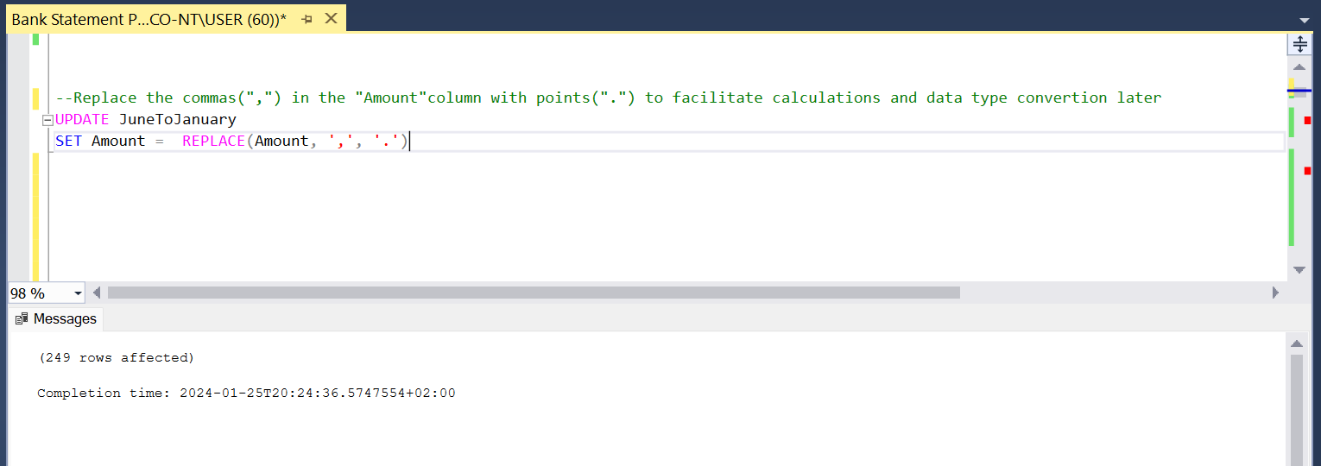
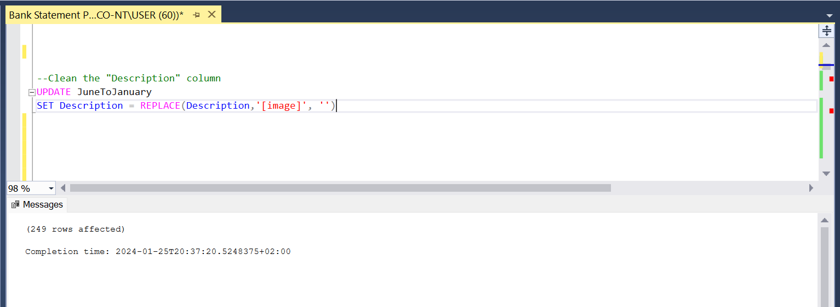
2. DATA PREPARATION
DATA CLEANING

Slide 7
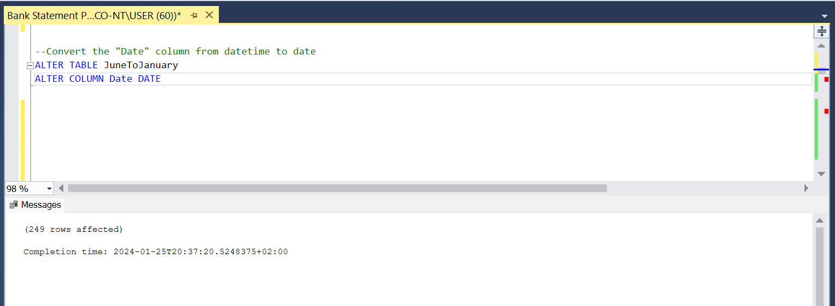
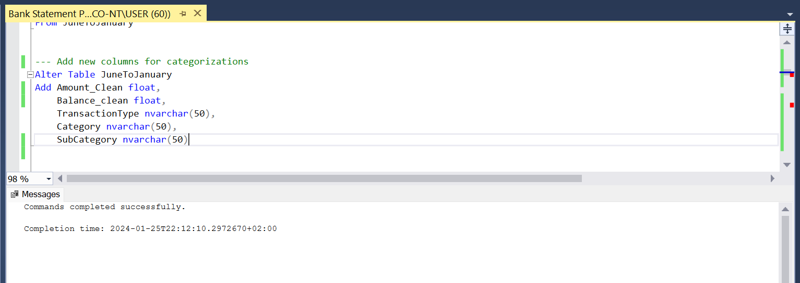
2. DATA PREPARATION
DATA CLEANING

Slide 8
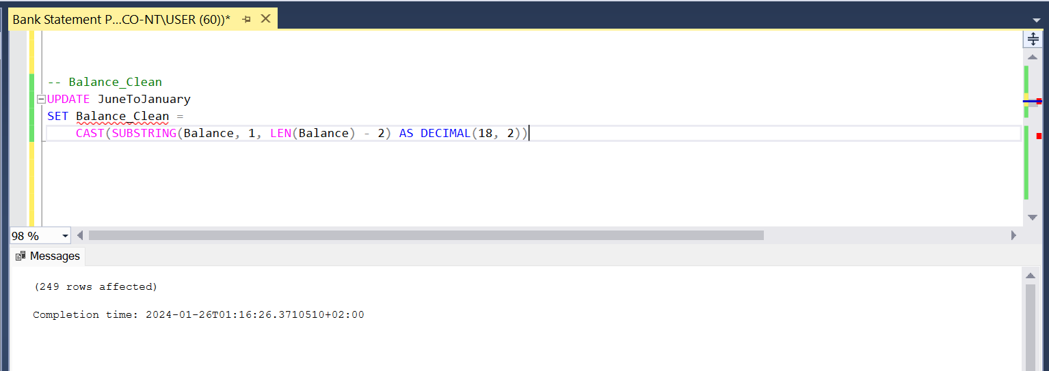
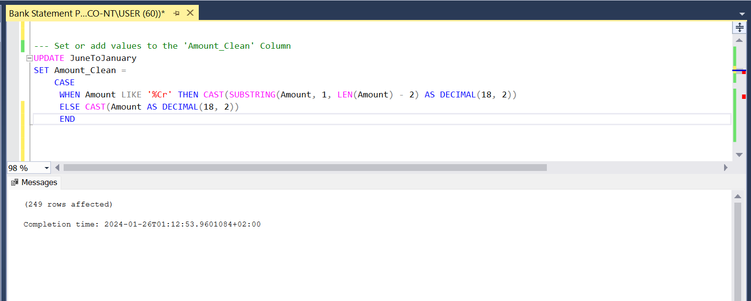
2. DATA PREPARATION
CLEANING ‘AMOUNT’ AND ‘BALANCE’ COLUMNS

Slide 9
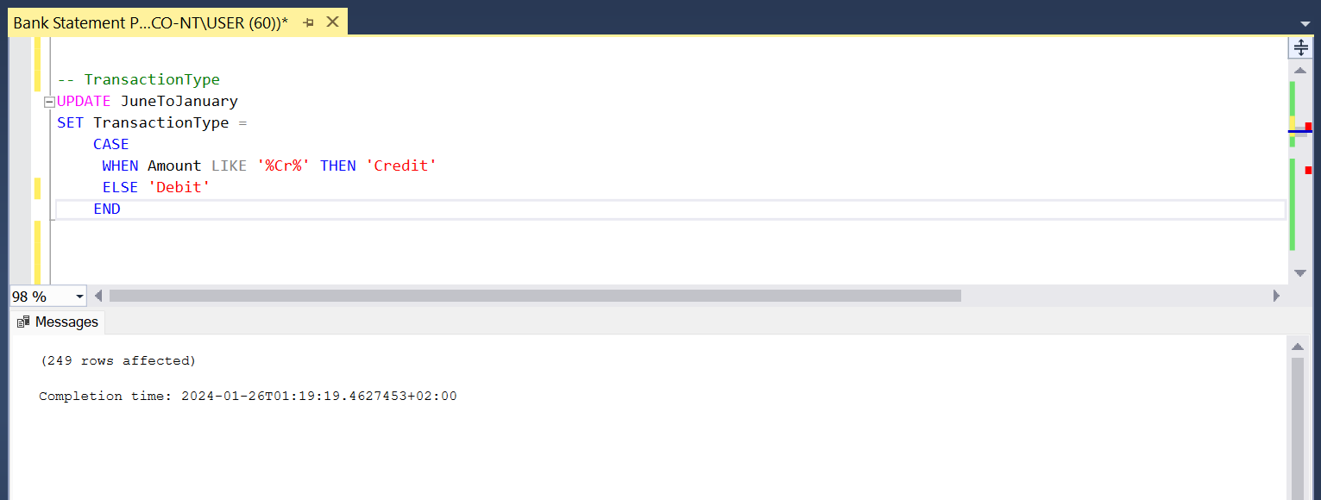
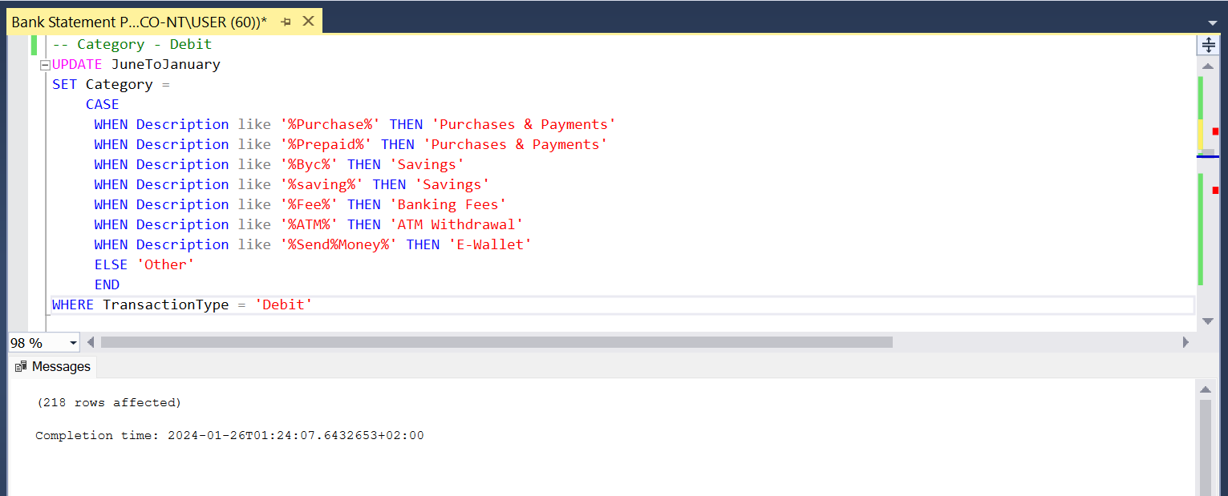
2. DATA PREPARATION
SET CONDITIONS FOR CATEGORIZATION – TRANSACTION TYPE AND DEBIT CATEGORIES

Slide 10
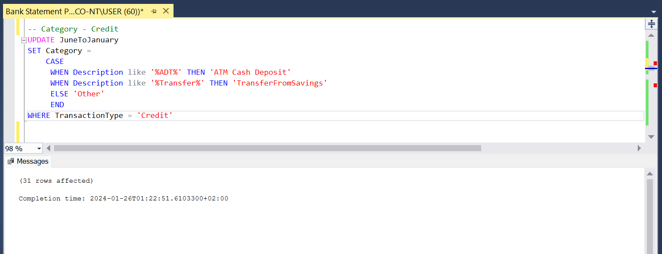
2. DATA PREPARATION
SET CONDITIONS FOR CATEGORIZATION – DEBIT CATEGORIES

Slide 11
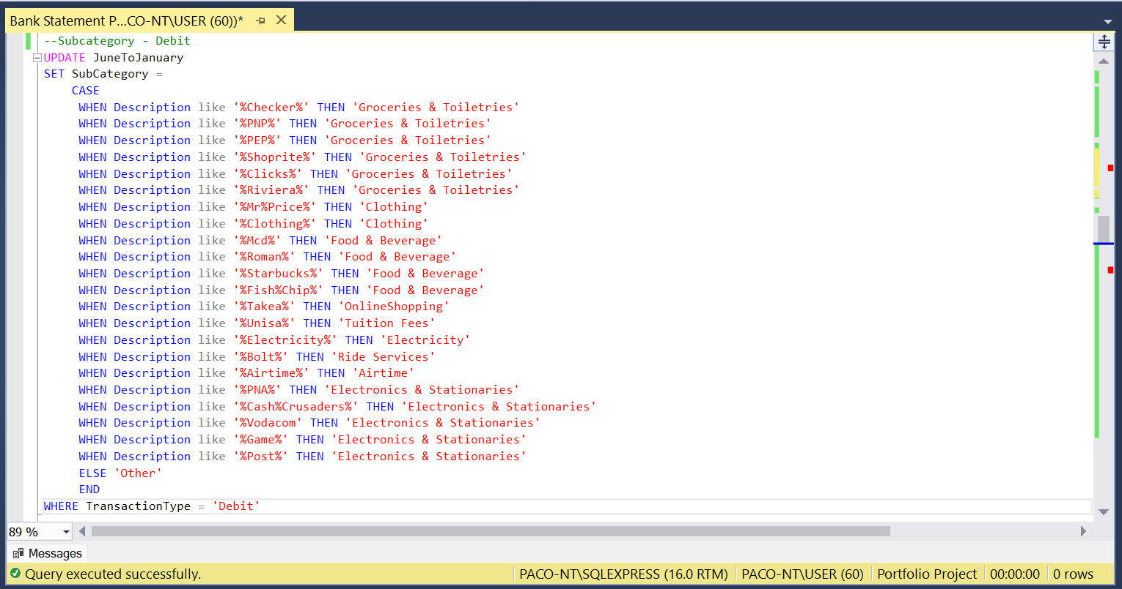
2. DATA PREPARATION
SET CONDITIONS FOR CATEGORIZATION – DEBIT SUBCATEGORIES

Slide 12
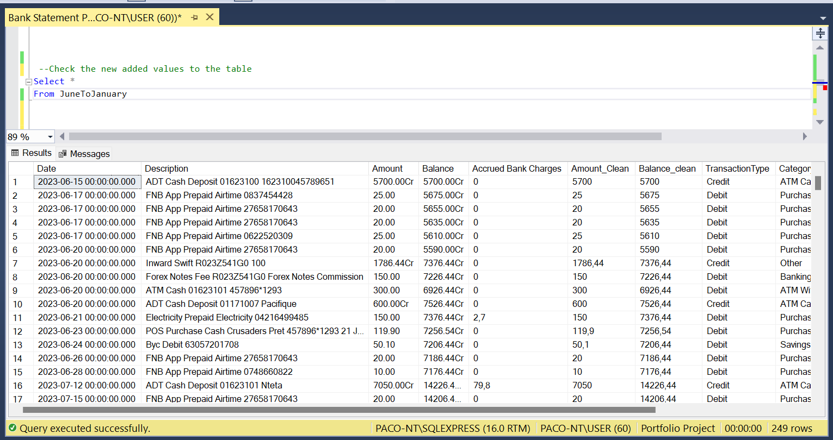
2. DATA PREPARATION
‘JUNETOJANUARY’ TABLE CHECK

Slide 13
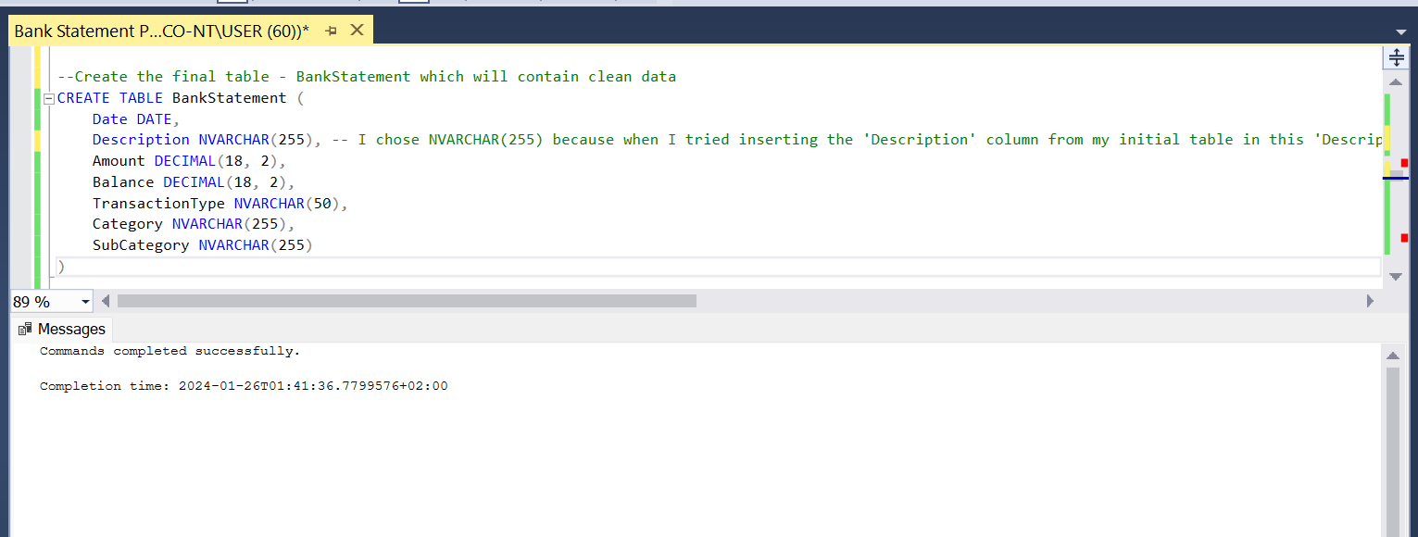
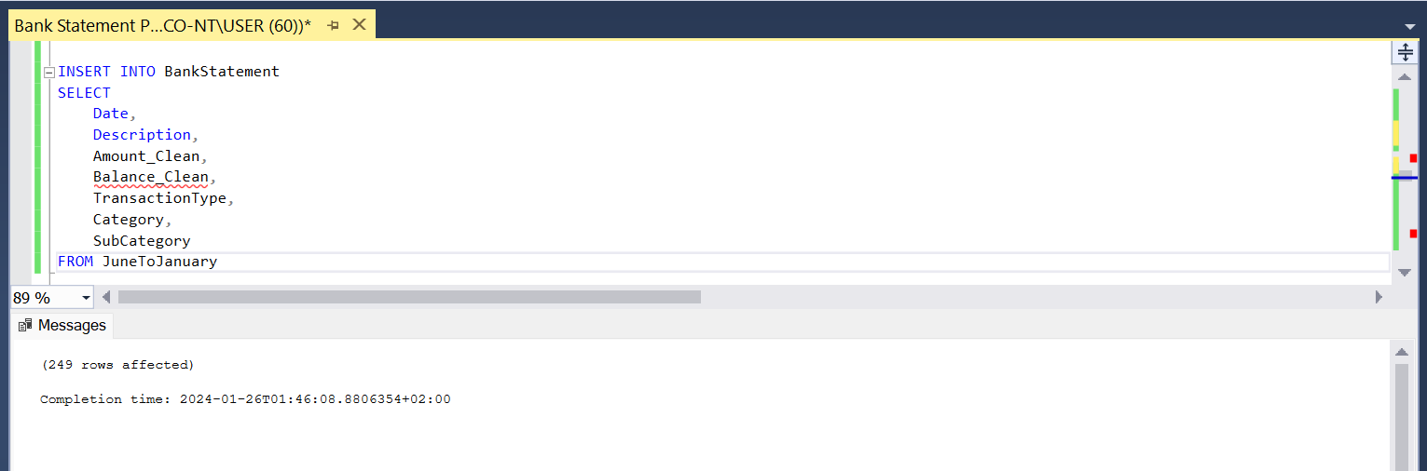
2. DATA PREPARATION
CREATE ‘BANKSTATEMENT’ TABLE

Slide 14
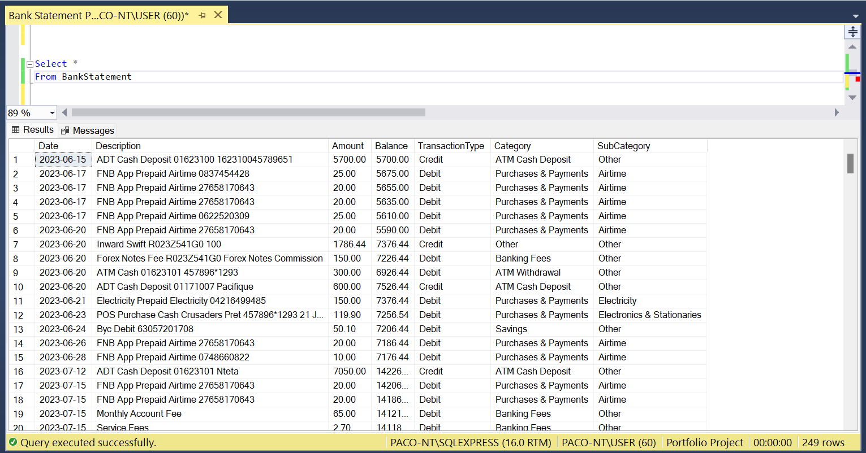
2. DATA PREPARATION
‘BANKSTATEMENT’ TABLE OVERVIEW

Slide 15
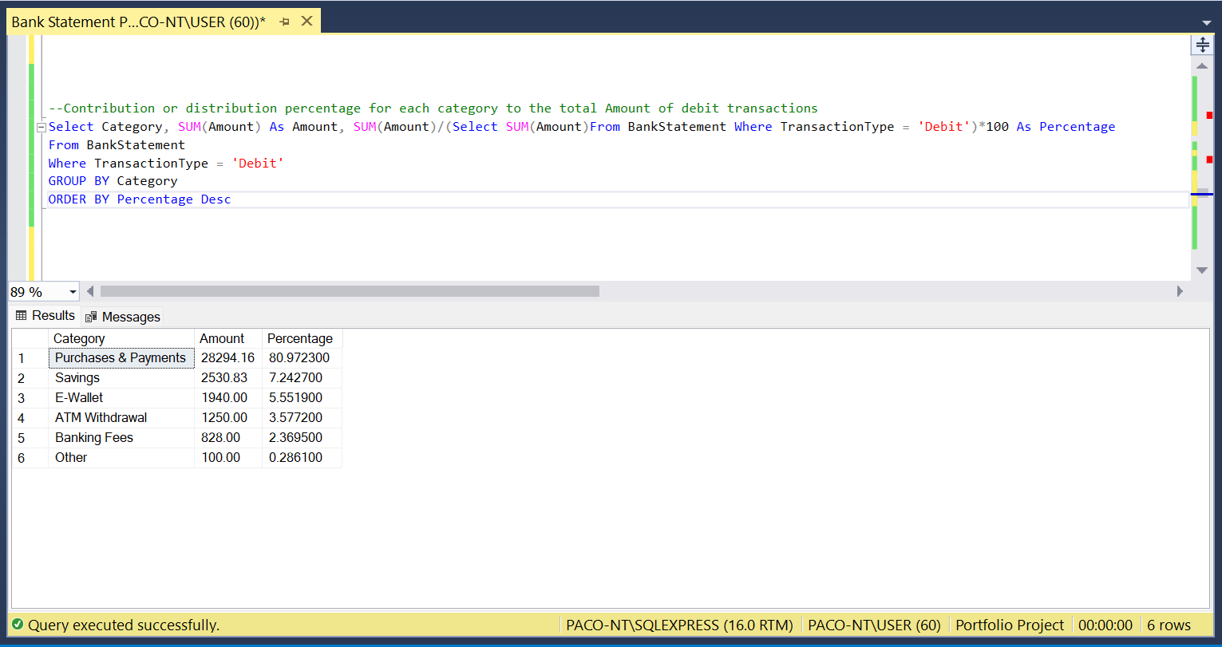
3. DATA EXPLORATION – EXPENSE AND INCOME TRACKING
CONTRIBUTION PERCENTAGE PER CATEGORY FOR DEBIT TRANSACTIONS

Slide 16
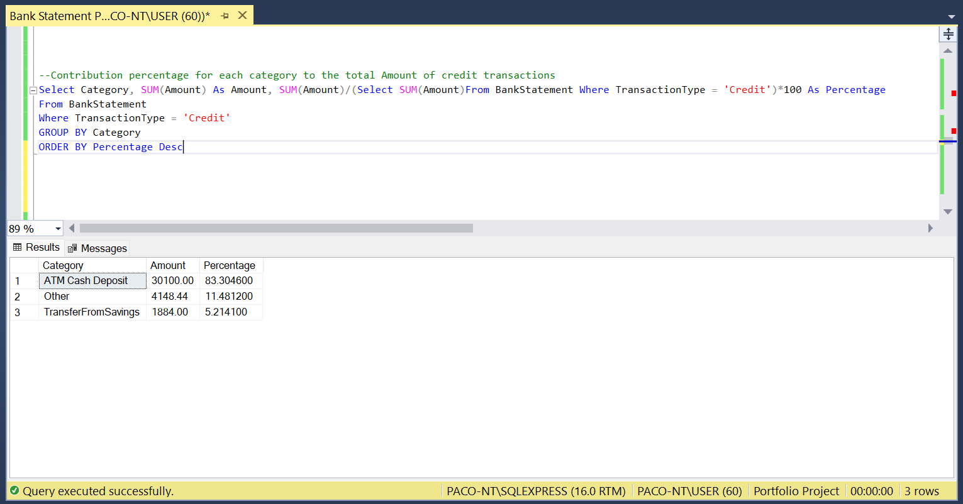
2. DATA EXPLORATION – EXPENSE AND INCOME TRACKING
CONTRIBUTION PERCENTAGE PER CATEGORY FOR CREDIT TRANSACTIONS

Slide 17
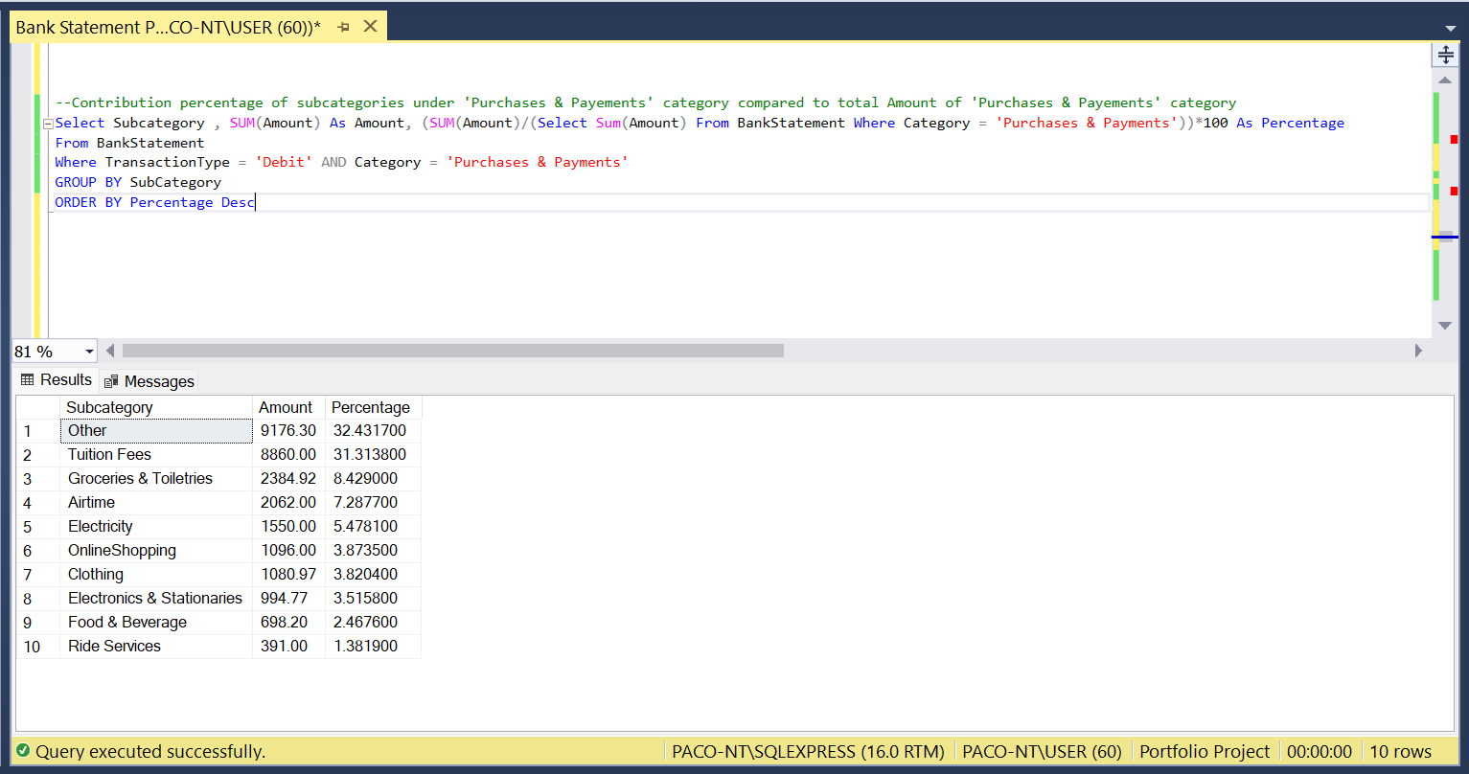
2. DATA EXPLORATION – EXPENSE AND INCOME TRACKING
CONTRIBUTION PERCENTAGE PER ‘PURCHASES & PAYMENTS’ SUBCATEGORIES
NOTE : CLICK ON THE FOLLOWING LINK TO SEE ALL THE QUERIES
https://github.com/PacificNt/Financial-Insights-from-Bank-Statement/blob/main/README.md

Slide 18
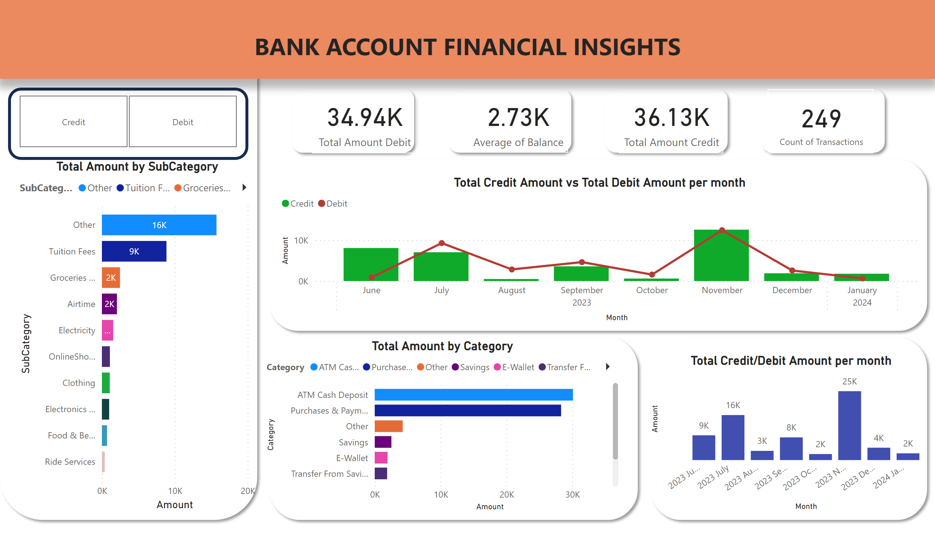

Slide 19
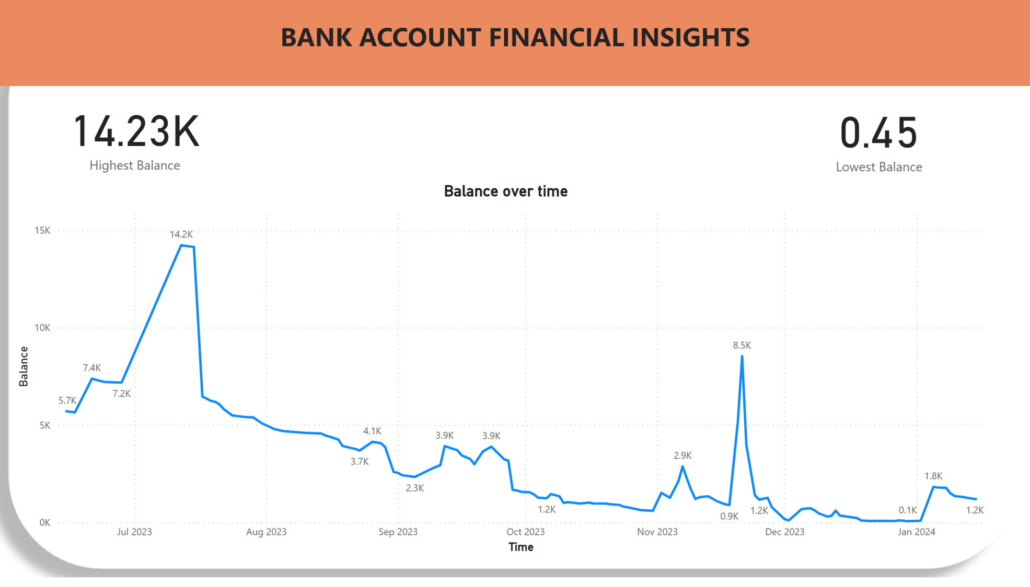

Slide 20
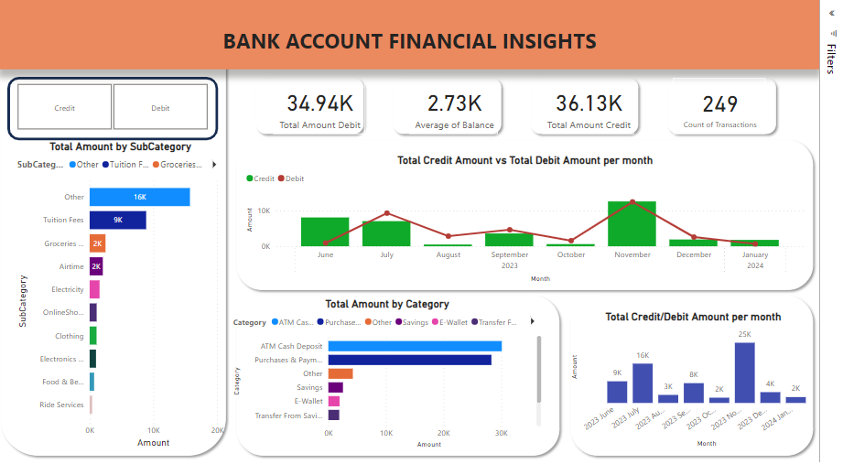

Slide 21
INSIGHTS SUMMARY
CREDIT
+/- 83%(or R30100) of incoming money in the account from June 2023(the 15th) to January 2024(the 15th) came from ATM Cash Deposit, while only 5%(R1884) came from the savings account. The remaining contribution(~11% or R4148.44) is classified as other. But since it represent a good 11% of the total contribution, it is also important to have a closer look at it and find out, what it represents.
The result shows that the highest Cash deposited on the account is R7100 and it was deposited on the 20th of November 2023 and as per the description it is referred to as 'Laptop Money’.
DEBIT
Around 81%(or R28294.16) of the money that went out of the account in the period covered in this table(15 June 2023 to 15 January 2024) went to 'Purchases & Payments', 7%(or R2530.83) went into savings, around 6%(or R1940.00) went to E-Wallets, around 3%(or R1250.00) went to ATM Withdrawals and around 2%(R828.00) went to Banking fees. The remaining contribution(0.2%0=) is classified as 'Other’.
The month of October was the month with the highest spending on 'Purchases & Payments' with R1276.3.
The month of September was the month with the highest spending on 'Groceries & Toiletries' with R728.45 while the month of July had the lowest amount spent on 'Groceries & Toiletries' with just R95.06

Slide 22
INSIGHTS SUMMARY
The biggest contribution(around 32% of total) in the ‘Purchases & Payments’ category is classified as 'Other'(We will have a closer look at it after). The second biggest contribution is 'Tuition Fees' which accounts around 31% of total contribution or R8860. The result shows that around R2062(or around 7%) was spent on 'Airtime' which is quite close to the amount spent on 'Groceries & Toiletries'(R2384.92 or around 8%). We can also highlight 'Ride Services' which accounts around 1% of total 'Purchase & Payments'. It is important to note here the amount on 'Ride Services' does not really reflect the reality as this reflects only rides that we paid with the Bank card; the rides paid in cash are not reflected here.
BALANCE
The average balance throughout the period covered in this project is R2730.
The highest 'Balance' registered in the account is R14226.44 and it was was registered on the 12th of December 2023.
The lowest 'Balance' was R0.45 and it was registered on the 27th of December 2023.

Slide 23
ACTIONS TO TAKE
1. MULTIPLY OR DIVERSIFY SOURCES OF INCOME.
As seen during the analysis, the account holder relies heavily on 'ATM Cash Deposit' (accounting for around 83% of income). Finding another source of income will help the account holder reduce dependence on 'ATM Cash Deposit' and lower associated banking fees.
2. BUDGET.
Budget Expenses
Many economists suggest a 50/30/20 or 50/40/10 budget plan, allocating 50% to savings, 30 to 40% to needs, and 10 to 20% wants. The account holder is spending around 81% on 'Purchases and Payments' which are not even all needs. He should review his spendings and allocate specific budgets to his needs and wants to fit the 30 to 40 and 10 to 20 model mentioned above, leaving the 50% remaining to savings.
The expense budget should also go down as far as to subcategories. A fixed amount should be allocated to all subcategories. Spending on 'Airtime' and 'Groceries & Toiletries' for example, are too close whereas one is a 'need' and the other is a 'want'. The spending on 'Airtime' should be reduced and such adjustment should be made on all subcategories by budgeting and reducing unnecessary spending.
Budget Savings
The account holder should review spendings and aim to allocate 50% of income to savings, which is currently at 7%. He should also adjust spending habits to achieve a more balanced budget.

Slide 24
ACTIONS TO TAKE
3. Manage Balance Fluctuations.
There is a significant difference between the highest and lowest balance. This inconsistency in balance is noticable throughout the whole period. The account holder can address this by applying above measures and maintaining financial discipline.

